Slide 1

Securing IoT Devices Utilizing Machine Learning Approach
By: Jasmine Roberts
Bowie State University
CTEC402-001
Spring 2023
March 16, 2023

Slide 2
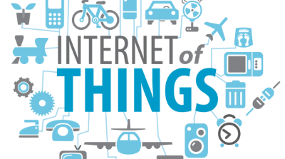
Introduction
Users that use multiple IoT devices, results into difficulty of security
As technology advances IoT devices/its data become more vulnerable
Without secuirty, your data will be seen and exposed
IoT devices consist of sensors, actuators, machines, etc.
IoT devices is being used for daily responsibilities which puts the data more at risk

Slide 3
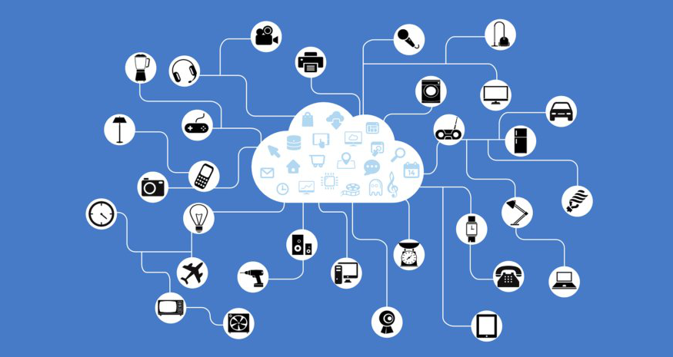
Methodologies: Securing IoT devices
This Photo by Unknown Author is licensed under CC BY-SA

Slide 4
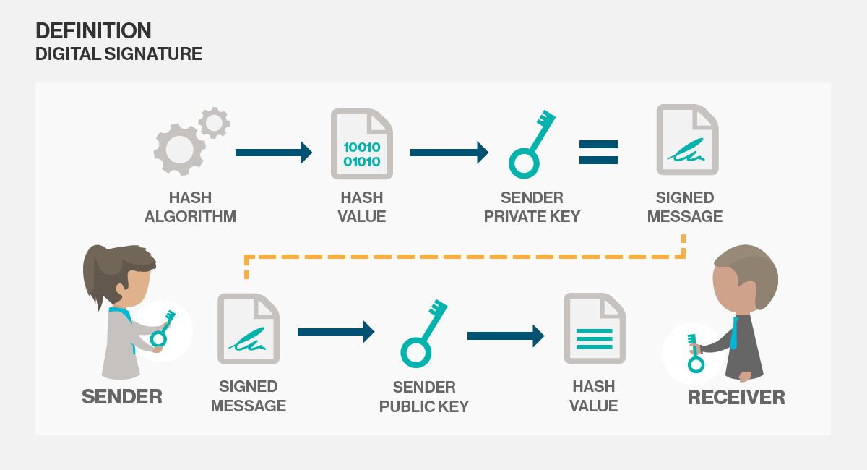
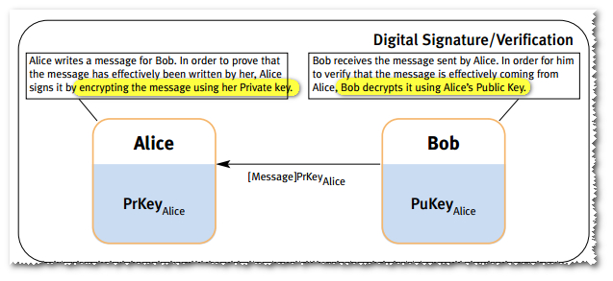
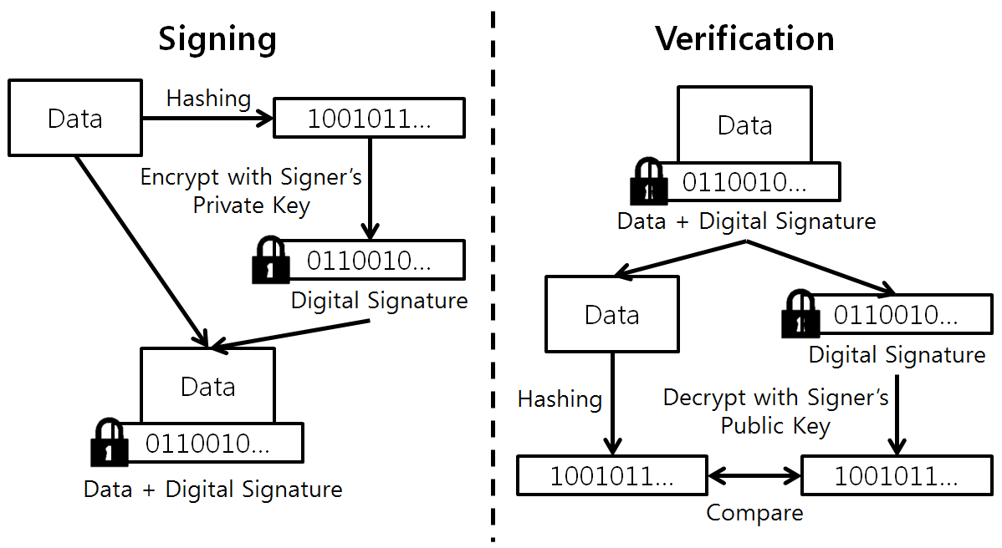
Method 1: Digital Signature Algorithm (Article: Digital Signature by Alexander S. Gillis)
Consist of validation of authenticity and integrity
Is used to provide proof of authentic data integrity and nonrepudiation of communications and transactions
The public key cryptography is a way of encryption
Two keys are generated creating a mathematically linked pair of keys (one is private and public).
Consist of a requirment that all partiers trust that the person who creates the signature image has kept the private key secret
If an unauthorized user has that “private” key it can result into fraudulent digital signatures in the name of the key holder.

Slide 5
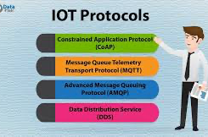
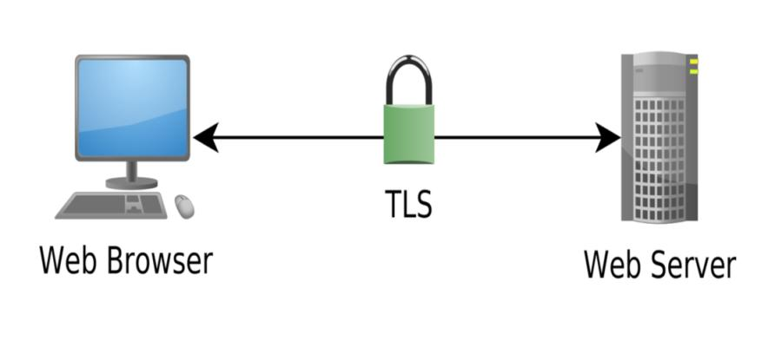
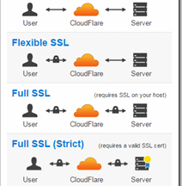
Method 2: Encrypted Secuirty Layers (Article: Secure your IoT Product: SSL/TLS, DTLS, SASL and DDS Explained by: Nadya Lukman)
Includes SSL and TLS
Has implementations in place for encryption/secuirty protocols
To acesss data of a IoT device, the server with SSL and TLS secuirty will first send a cryptographic key to the identified partner
The key is classified into three parts (session, public and private key)
SSL/TSL consist of 2 types of encryption (asymmetric and symmetric)
SSL/TSL is the MQTT protocol (MQ Telemetry Transport), which a protocol for IoT messaging and data.
Consists of bidirectional data transfer, provides your device with added secuirty and identifiys clients
DDS protocol provides data tagging for data tracking

Slide 6
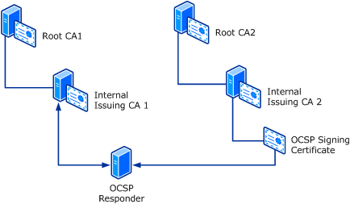
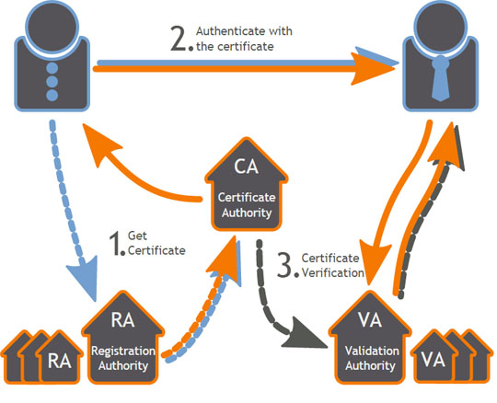
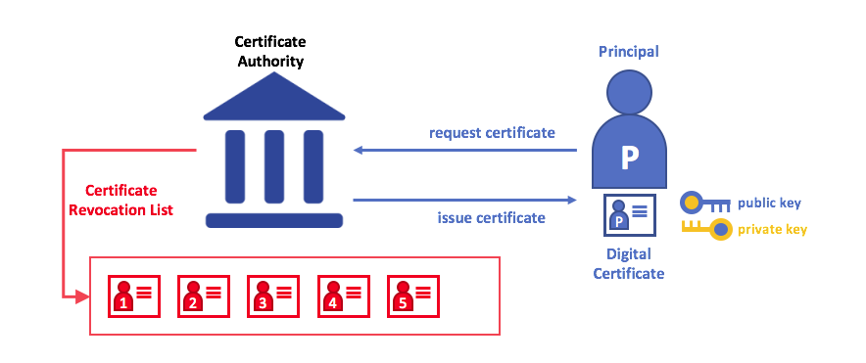
Method 3: Public Key Infrastructure (PKI) (Article: What is PKI and How Dows it Work? By: KEYFACTOR)
Issues digital certificates that protect sensitive data
Assigns identities to keys so that recipients can verify the owners accurately
Allows you to encrypt or sign data (can be used to secure your data or identify a user)
It protects and authenticate data between servers, devices and users.
Includes Certificate and Registration Authority, Certificate Database, and Certificate Policy.

Slide 7
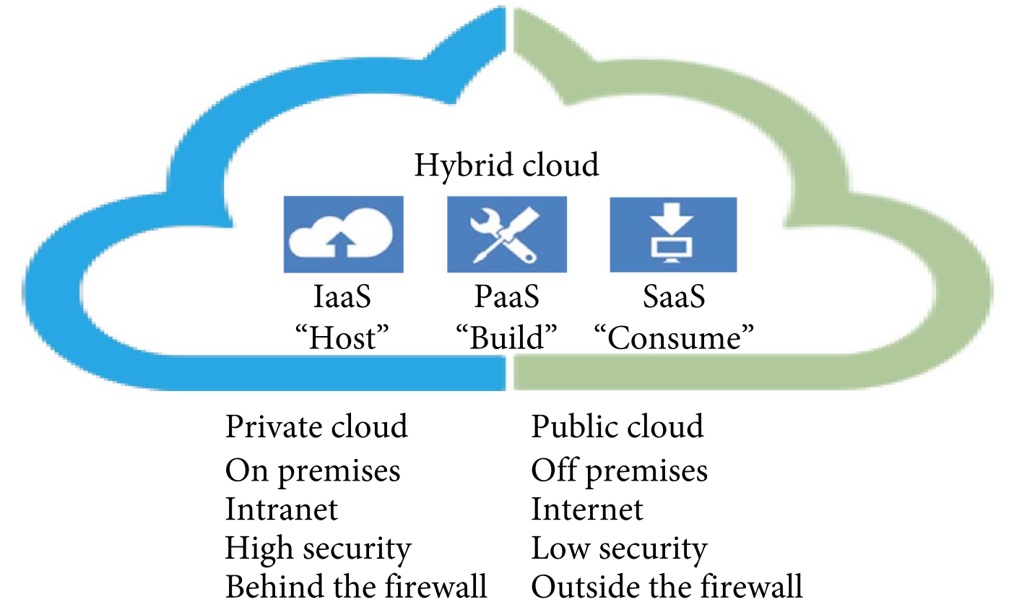
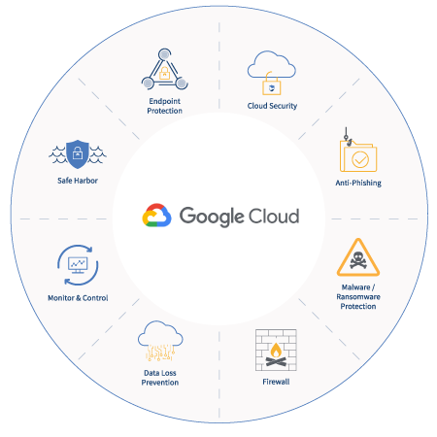
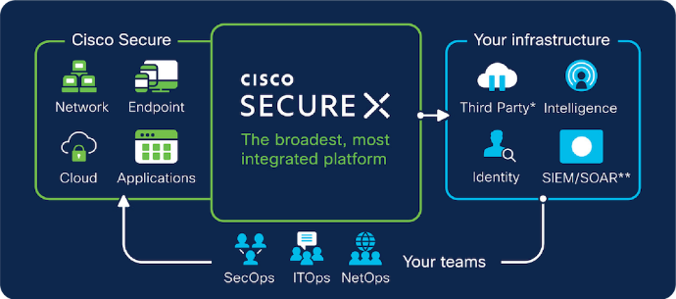
Method 4: Secured Cloud Platform (Article: What is cloud secuirty? By: BOX)
Consists of improving data accessibility
Includes user and device authentication, data resource access control and data privacy protection
Can protect your IoT device’s data from Distributed Denial of Serves (DDoS) attacks, and unauthorized access and use.
There are three types of cloud platforms you can chose from (Public Clouds, Private Clouds, and Hybrid Clouds)

Slide 8
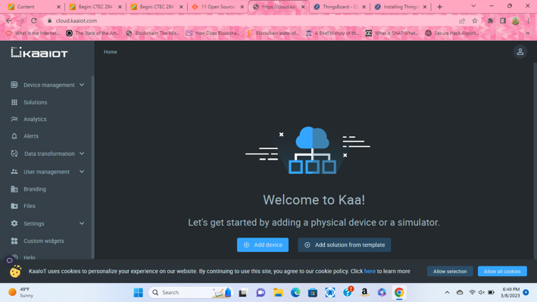

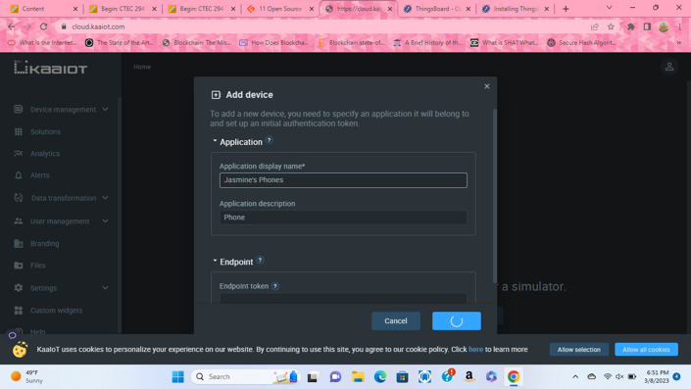
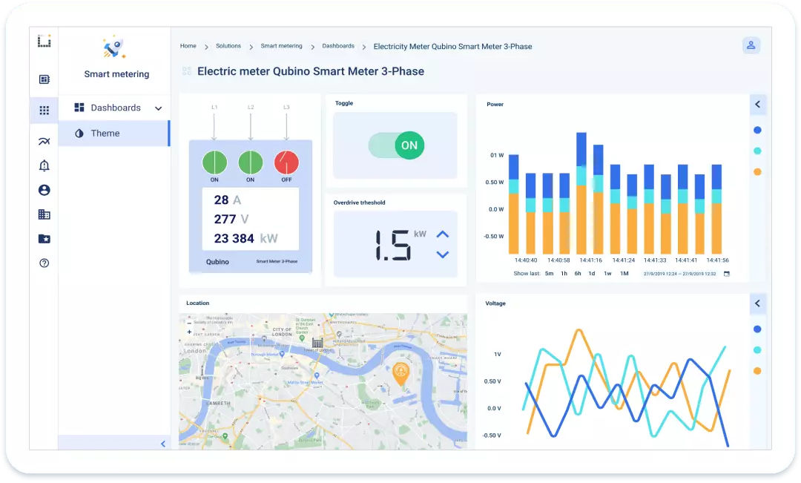
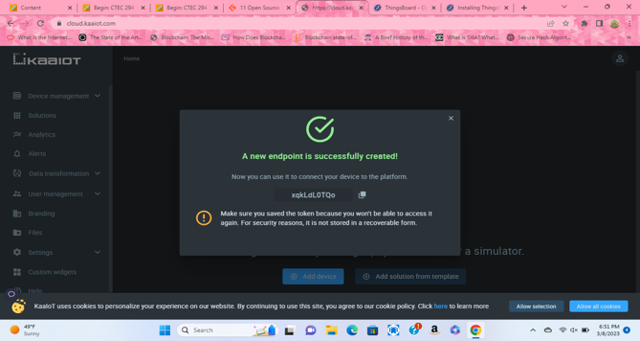
Method 5: KAA IoT Software
An open-source free software
A PaaS (Platform-as-a-service)
Used for device management, data collection/monitoring, analytics and visualization, remote control, and software updates
Add your IoT devices to the cloud and mangae their status and activity.
Can implement real time bidirectional data exchanges with the server for security
Its data collection consist of collecting your data on a larger scale/configure data processing pipelines

Slide 9
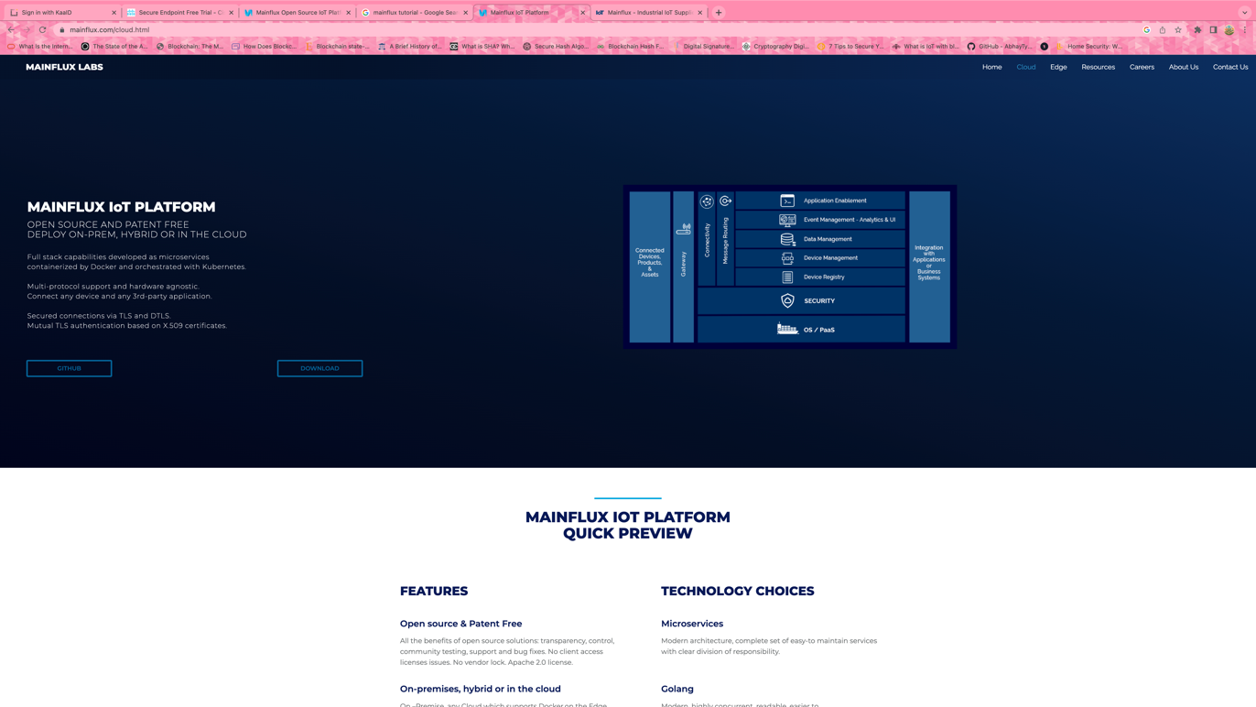
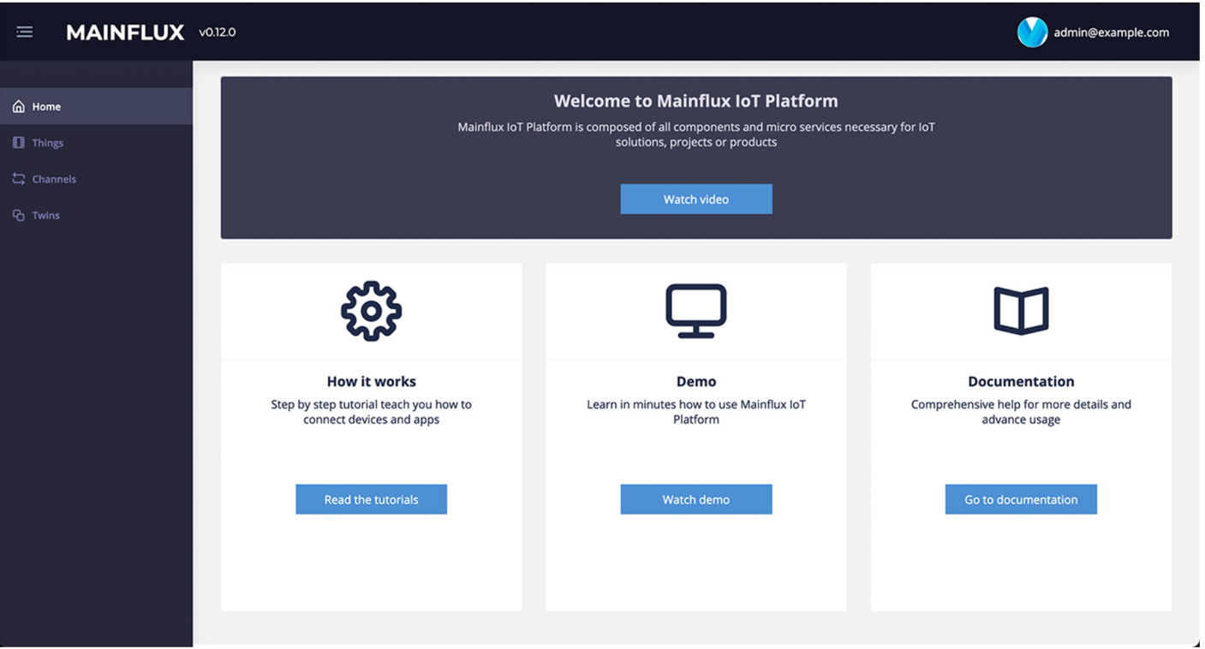
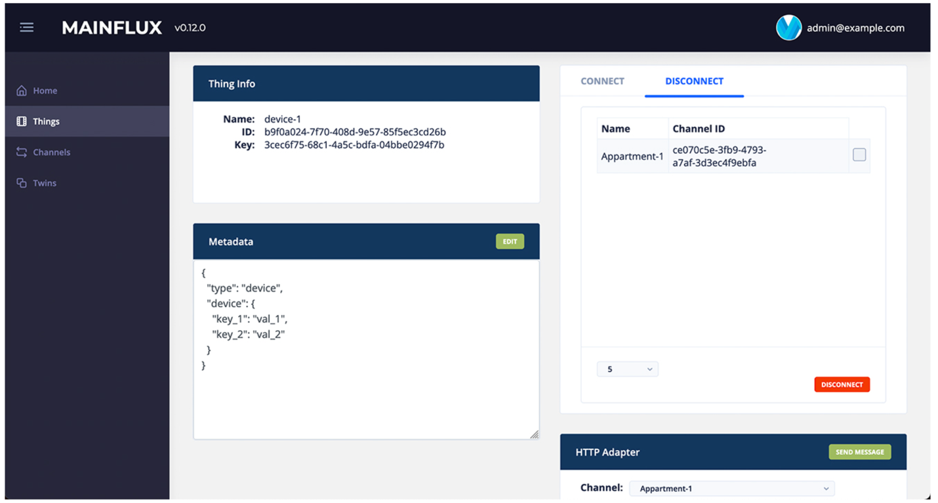
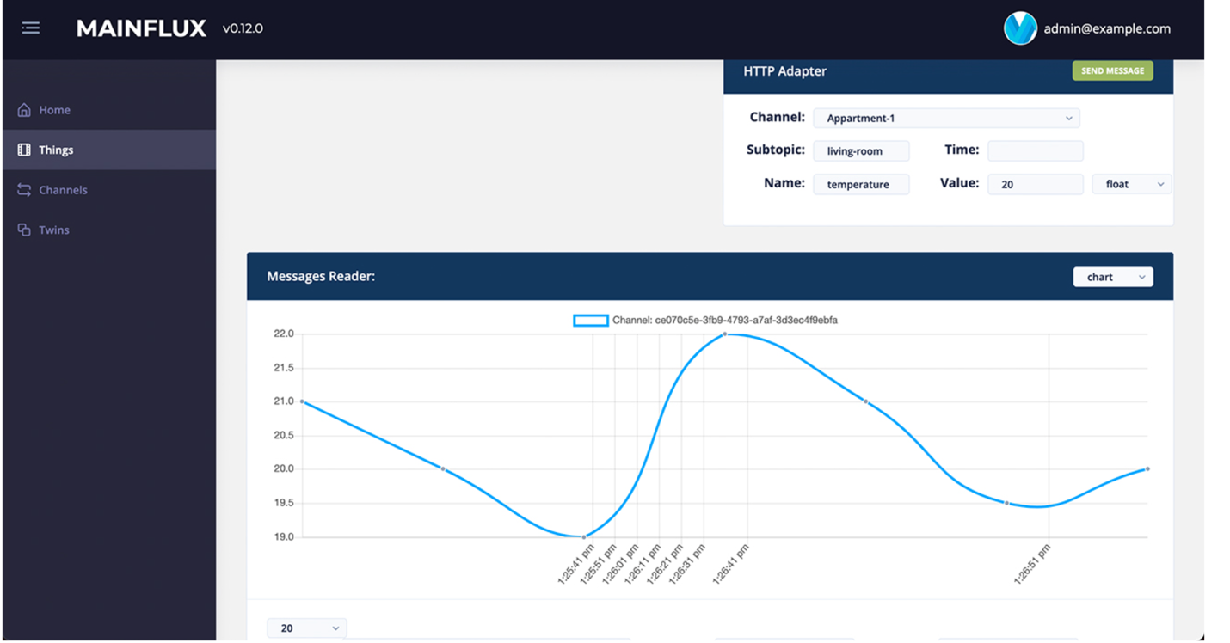
Method 6: Mainflux IoT Gateway and Device Management
Is an open-source free software
Helps secure IoT devices and its data
Acts as software instructors/middleware
Provides Device Management, Data Aggregation and Data Management, Connectivity and Message Routing
Is founded by Linux and is compatible with Linux, and etc.

Slide 10
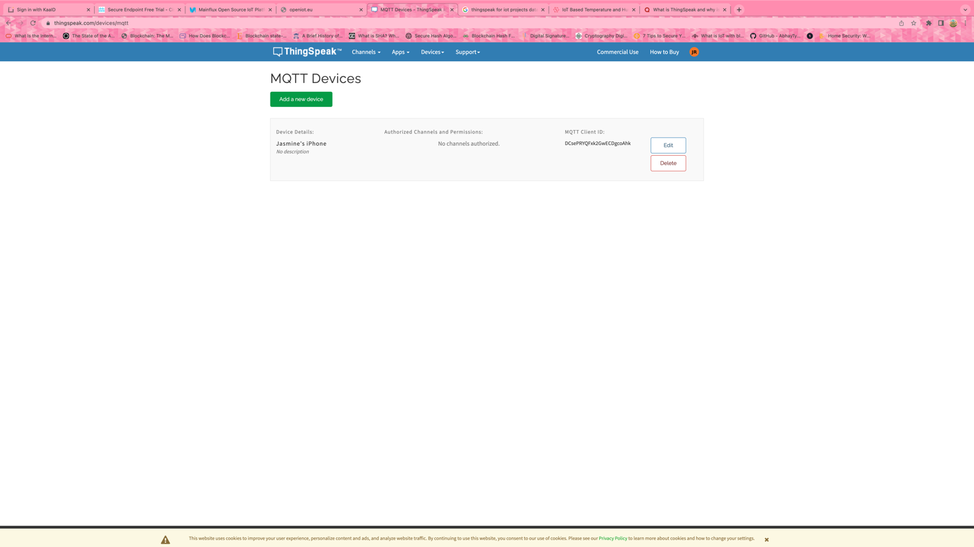
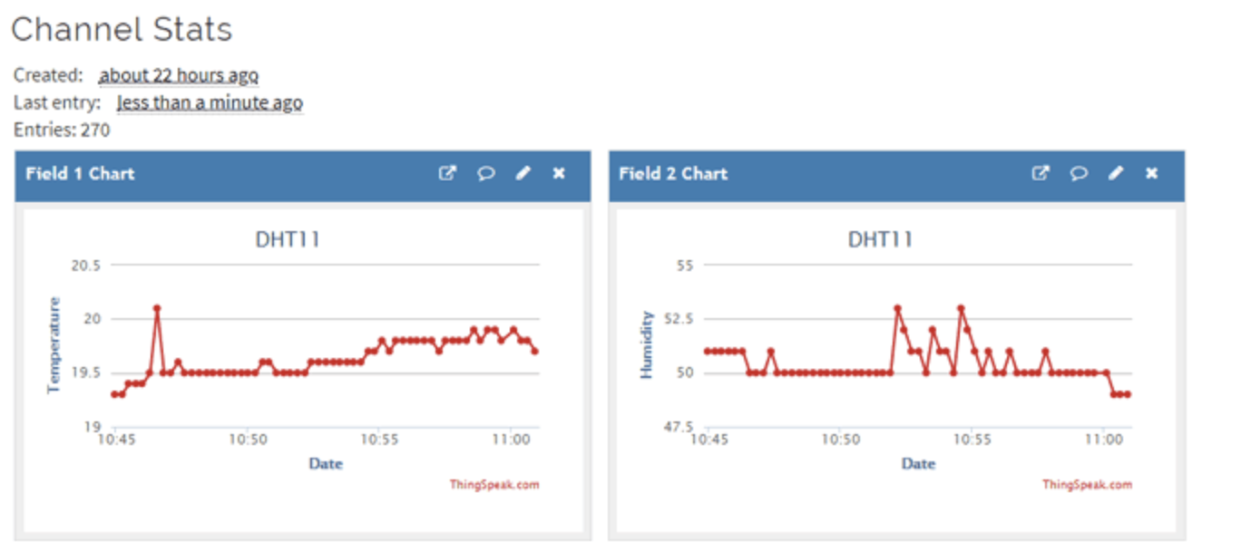
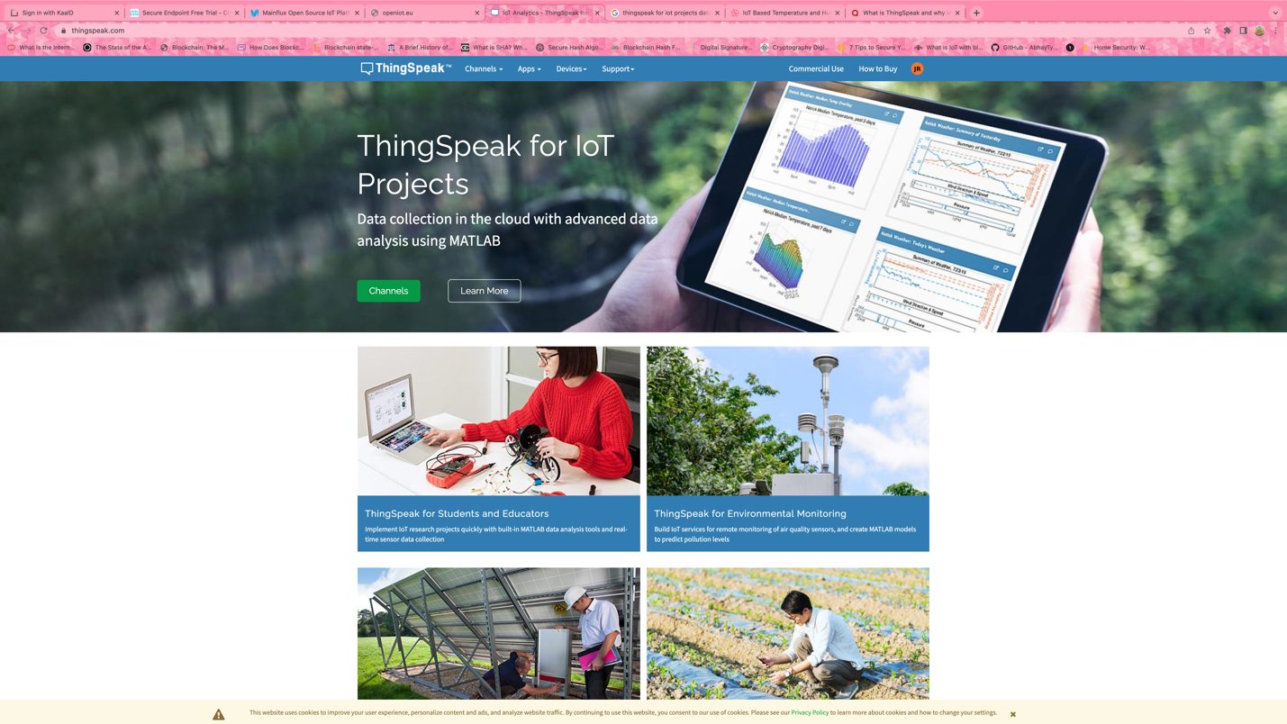
Method 7: ThingSpeak for IoT Projects
A platform to connect IoT devices to its software and collect its data through the cloud
Allows you to aggregate, visualize and analyze live data streams inside of the cloud
Can analzye your data
Can send data to ThingSpeak from your device and create live data that you can see
This is a way to be able to monitor your data to see if its secured or not secured
Open-source free software

Slide 11
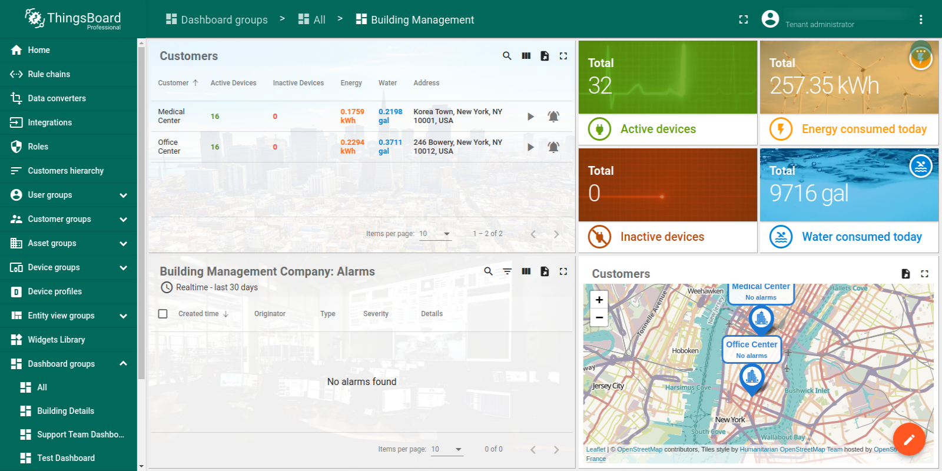
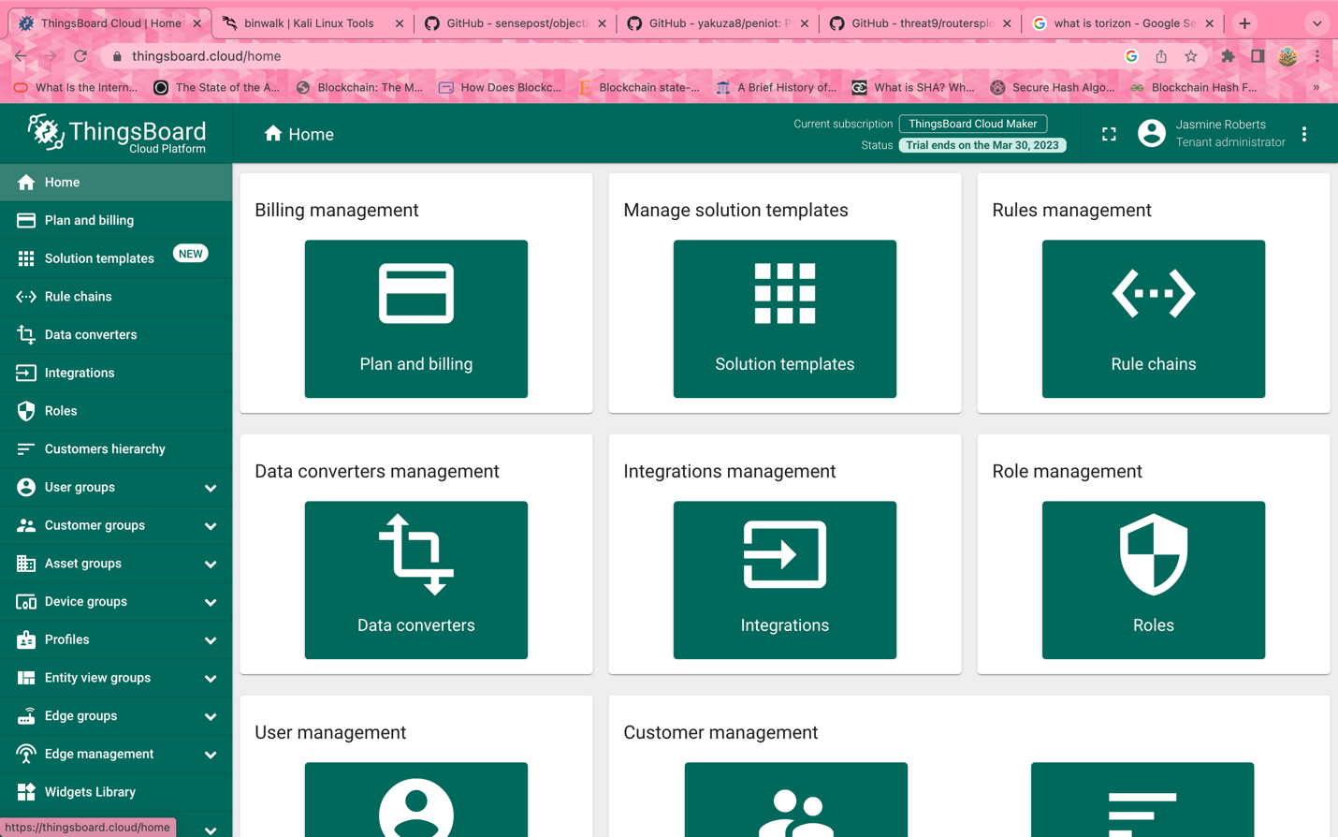
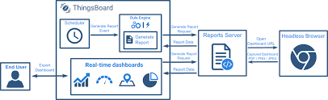
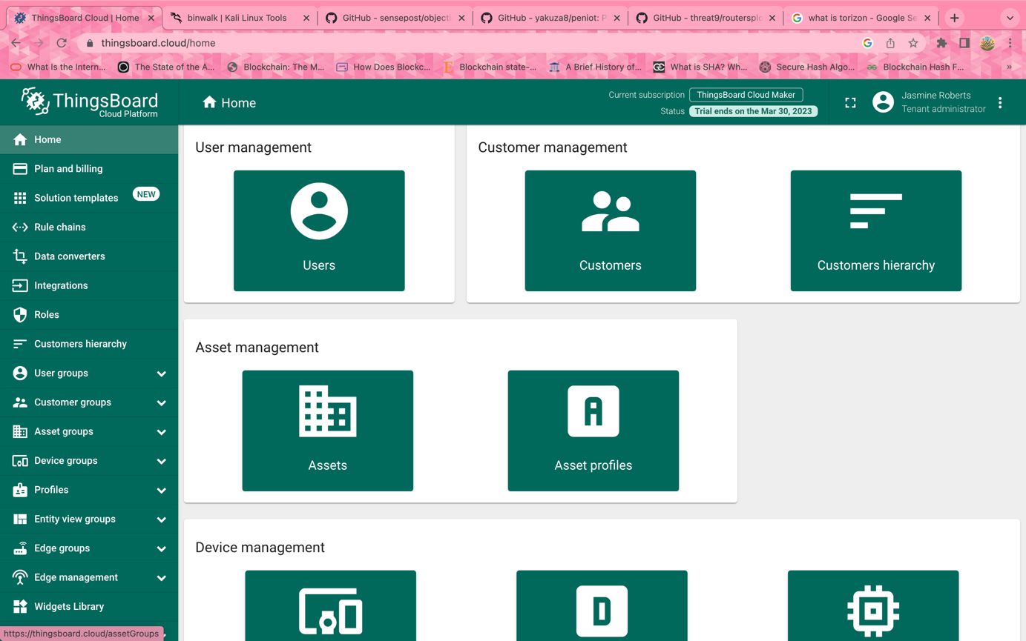
Method 8: ThingsBoard Cloud
Open-source free platform
Provides you to collect/visualize data from your IoT device and its assets.
Can control your device remotely, and analzye incoming traffic
Enables rapid development, management, and scaling of your IoT device
Includes HTTP to transfer information between its devices that is on the network.
It uses two databases such as SQL and NoSGL Database
Inside of the “cloud” you can manage, process, analyze and update your data safely, remotely and in real time

Slide 12

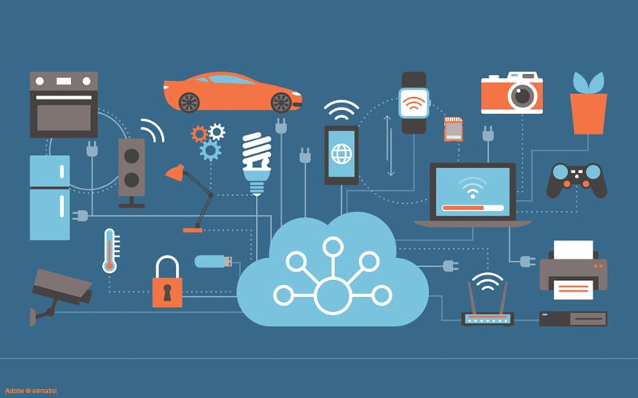
Summary
In conclusion:
There are many methodologies to help secure your IoT device and its data
Unfortunately, many users still won’t be influenced by the strong recommendation of enforcing security on their devices until an actual vulnerability happens to them
As technology advances and as automation becomes the way of life there will be more unauthorized
Not everyone is going to take initiative to protect their device,
It’s recommended to get secuirty because you will put yourself at risk just by not having any secuirty

Slide 13
References
Works Cited
Documentation: What is ThingsBoard? (n.d.). Retrieved March 2023, from Things Board: https://thingsboard.io/docs/getting-started-guides/what-is-thingsboard/
Fruhlinger, J. (2020, May 29). What is PKI? And how it secures just about everything online. Retrieved from CSO: https://www.csoonline.com/article/3400836/what-is-pki-and-how-it-secures-just-about-everything-online.html
Gillis, A. S. (n.d.). Definition: Digital Signature. Retrieved March 2023, from Tech Target: Secuirty: https://www.techtarget.com/searchsecurity/definition/digital-signature
IoT Devices. (n.d.). Retrieved March 2023, from ARM: https://www.arm.com/glossary/iot-devices#:~:text=IoT%20devices%20are%20pieces%20of,the%20internet%20or%20other%20networks.
KEYFACTOR. (n.d.). Retrieved March 2023, from What is PKI and How Does it Work?: https://www.keyfactor.com/resources/what-is-pki/
Lukman, N. (2021, September 23). Securing your IoT Product: SSL/TLS, DTLS, SASL, and DDS Explained. Retrieved from NexPCB: https://www.nexpcb.com/blog/protocol-security
Mainflux IoT Gateway and Device Management. (n.d.). Retrieved March 2023, from Mainflux Labs: Remote Deivce Management: https://mainflux.com/iot-device-management.html
Mainflux: From the Cloud to the Ground. (n.d.). Retrieved March 2023, from IoT One: https://www.iotone.com/supplier/mainflux/v2361
Nalley, J. (n.d.). Excellarate. Retrieved March 2023, from The Kaa IoT Platform Tutorial: https://www.excellarate.com/blogs/the-kaa-iot-platform-tutorial/#:~:text=Kaa%20is%20a%20multi%2Dpurpose,in%20for%20a%20quick%20start.
The Most Flexible IoT Platform For Your Business. (n.d.). Retrieved March 2023, from KAA: https://www.kaaiot.com/
ThingSpeak for IoT Projects. (n.d.). Retrieved March 2023, from ThingSpeak: https://thingspeak.com/
What is Cloud Secuirty. (n.d.). Retrieved March 2023, from BOX: https://www.box.com/resources/what-is-cloud-security#:~:text=Definition%20of%20cloud%20security,control%2C%20and%20data%20privacy%20protection.

